Slide 1

SQLAlchemy
The Python SQL Toolkit and Object Relational Mapper

Slide 2
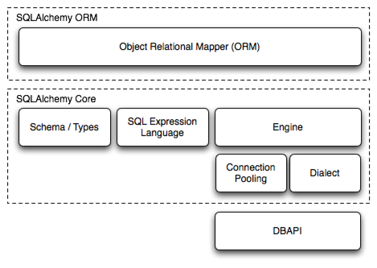
Visión general
El kit de herramientas SQL de SQLAlchemy y el mapeador relacional de objetos es un conjunto completo de herramientas para trabajar con bases de datos y Python. Cuenta con varias áreas diferenciadas de :funcionalidad que se puede utilizar individualmente o combinada junto. Sus componentes principales se ilustran a continuación, con dependencias de componentes organizadas en capas
Arriba, las dos partes frontales más significativas de SQLAlchemy son el Mapeador Relacional de Objetos y el Lenguaje de Expresión SQL. Se pueden utilizar expresiones SQL independientemente de la ORM. Cuando se utiliza el ORM, el archivo SQL El lenguaje de expresión sigue formando parte de la API de cara al público ya que se utiliza dentro de las configuraciones relacionales de objetos y Consultas.

Slide 3
SQLAlchemy
Basado en la Presentacion de Muhammet S. AYDIN
Python Developer @ Metglobal @mengukagan

Slide 4

SQLAlchemy
No ORM Required
Mature
High Performing
Non-opinionated
Unit of Work
Function based query construction
Modular

Slide 5
SQLAlchemy
Seperation of mapping & classes
Eager loading & caching related objects
  Inheritance mapping
    Raw SQL

Slide 6

SQLAlchemy
Dri ers:
PostgreSQL MySQL MSSQL
SQLite Sybase Drizzle Firebird Oracle

Slide 7

SQLAlchemy
Core

Slide 8
SQLAlchemy
Core
Engine Connection Dialect MetaData Table Column

Slide 9
SQLAlchemy
Core
Engine
Starting point for SQLAlchemy app.
Home base for the database and it's API.

Slide 10

SQLAlchemy
Core
Connection
Provides functionality for a wrapped DB-API connection.
Executes SQL statements.
Not thread-safe.

Slide 11

SQLAlchemy
Core
Dialect
Defines the behavior of a specific database and DB-API combination.
Query generation, execution, result handling, anything that differs from other dbs is handled in Dialect.

Slide 12

SQLAlchemy
Core
MetaData
Binds to an Engine or Connection.
Holds the Table and Column metadata in itself.

Slide 13

SQLAlchemy
Core
Table
Represents a table in the database.
Stored in the MetaData.

Slide 14

SQLAlchemy
Core
Column
Represents a column in a database table.

Slide 15
SQLAlchemy
Core
Creating an engine:

Slide 16

SQLAlchemy
Core
Creating tables
Register the Table with MetaData.
Define your columns.
Call metadata.create_all(engine) or
table.create(engine)

Slide 17
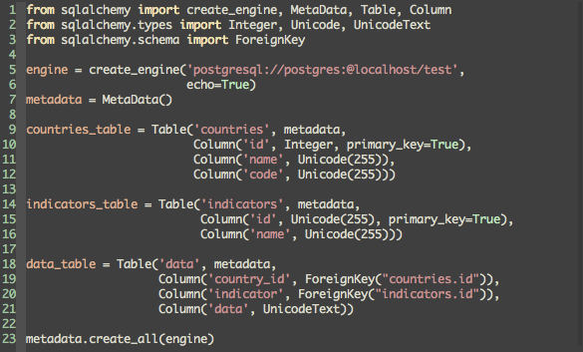
SQLAlchemy
Core
Creating tables

Slide 18

SQLAlchemy
Core
More on Columns
Columns have some important parameters.
index=bool, nullable=bool, unique=bool, primary_key=bool, default=callable/scalar, onupdate=callable/scalar, autoincrement=bool

Slide 19

SQLAlchemy
Core
Column Types
Integer
BigInteger
String
Unicode
UnicodeText
Date
DateTime
Boolean
Text
Time and
All of the SQL std types

Slide 20
SQLAlchemy
Core
Insert
insert = countries_table.insert().values( code='TR', name='Turkey')
conn.execute(insert)

Slide 21
SQLAlchemy
Core
Select
select([countries_table])
select([ct.c.code, me])select([ct.c.code.label('c')])

Slide 22

SQLAlchemy
Core
Select
select([ct]).where(ct.c.region == 'Europe & Central Asia')
select([ct]).where(or_(ct.c.region.ilike('%euro pe%', ct.c.region.ilike('%asia%')))

Slide 23
SQLAlchemy
Core
Select A Little Bit Fancy
select([func.count(ct.c.id).label('count'), ct.c.region]).group_by(ct.c.region).order_by(' count DESC')
SELECT count(countries.id) AS count, countries.region
FROM countries GROUP BY countries.region ORDER BY count DESC

Slide 24

SQLAlchemy
Core
Update
ct.update().where(ct.c.id == 1).values(name='Turkey', code='TUR')

Slide 25
SQLAlchemy
Core
Cooler Update
case_list = [(pt.c.id == photo_id, index+1) for index, photo_id in enumerate(order_list)]
pt.update().values(photo_order=case(case_list))
UPDATE photos SET photo_order=CASE WHEN (photos.id = :id_1) THEN :param_1 WHEN (photos.id
= :id_2) THEN :param_2 END

Slide 26

SQLAlchemy
Core
Delete
ct.delete().where(ct.c.id_in([60,71,80,97]))

Slide 27
SQLAlchemy
Core
Joins
select([ct.c.name, dt.c.data]).select_from(ct.join(dt)).where(ct.c
.code == 'TRY')

Slide 28
SQLAlchemy
Core
Joins
select([ct.c.name, dt.c.data]).select_from(join(ct, dt, ct.c.id == dt.c.country_id)).where(ct.c.code == 'TRY')

Slide 29
SQLAlchemy
Core
Func
A SQL function generator with attribute access.
simply put: func.count() becomes COUNT().

Slide 30
SQLAlchemy
Core
Func
select([func.concat_ws(“ -> “, ct.c.name, ct.c.code)])
SELECT concat_ws(%(concat_ws_2)s, countries.name, countries.code) AS concat_ws_1
FROM countries

Slide 31
SQLAlchemy
ORM

Slide 32
SQLAlchemy
ORM
- Built on top of the core
- Applied usage of the Expression Language
- Class declaration
- Table definition is nested in the class

Slide 33
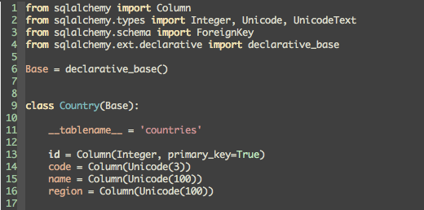
SQLAlchemy
ORM
Defnition

Slide 34
SQLAlchemy
ORM
Session
Basically it establishes all connections to the db.
All objects are kept on it through their lifespan.
Entry point for Query.

Slide 35

SQLAlchemy
ORM
Master / Sla e Connection?
master_session = sessionmaker(bind=engine1)
slave_session = sessionmaker(bind=engine2)
Session = master_session() SlaveSession = slave_session()

Slide 36
SQLAlchemy
ORM
Querying
Session.query(Country).filter(Country.name.s tartswith('Tur')).all()
Session.query(func.count(Country.id)).one()
Session.query(Country.name, Data.data).join(Data).all()

Slide 37
SQLAlchemy
ORM
Querying
Session.query(Country).filter_by(id=1).updat e({“name”: “USA”})
Session.query(Country).filter(~Country.regio n.in_('Europe & Central Asia')).delete()

Slide 38
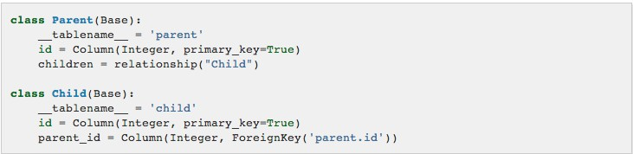
SQLAlchemy
ORM
Relationships: One To Many

Slide 39
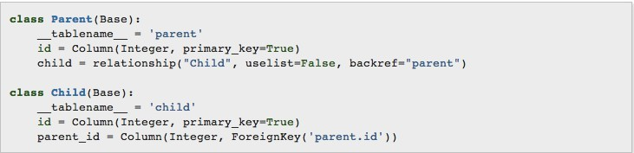
SQLAlchemy
ORM
Relationships: One To One

Slide 40
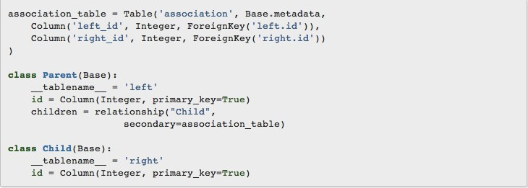
SQLAlchemy
ORM
Relationships: Many To Many

Slide 41
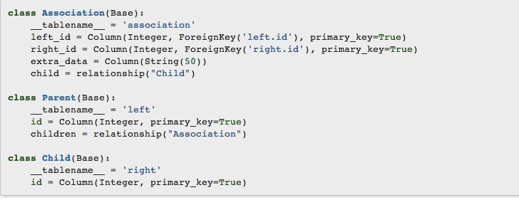
SQLAlchemy
ORM
Relationships: Many To Many

Slide 42
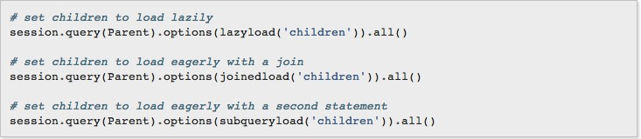
SQLAlchemy
ORM
Relationship Loading

Slide 43
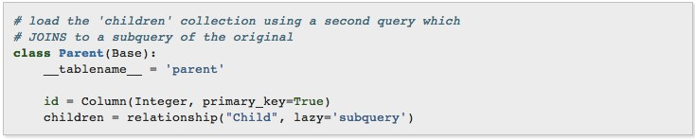
SQLAlchemy
ORM
Relationship Loading

Slide 44
SQLAlchemy
ORM
More in Code?

